Slide 1
Mini Kenterprise Graphics
Last Updated 23.02.2022 | WORK IN PROGRESS

Slide 2

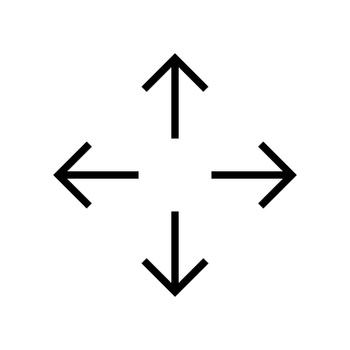
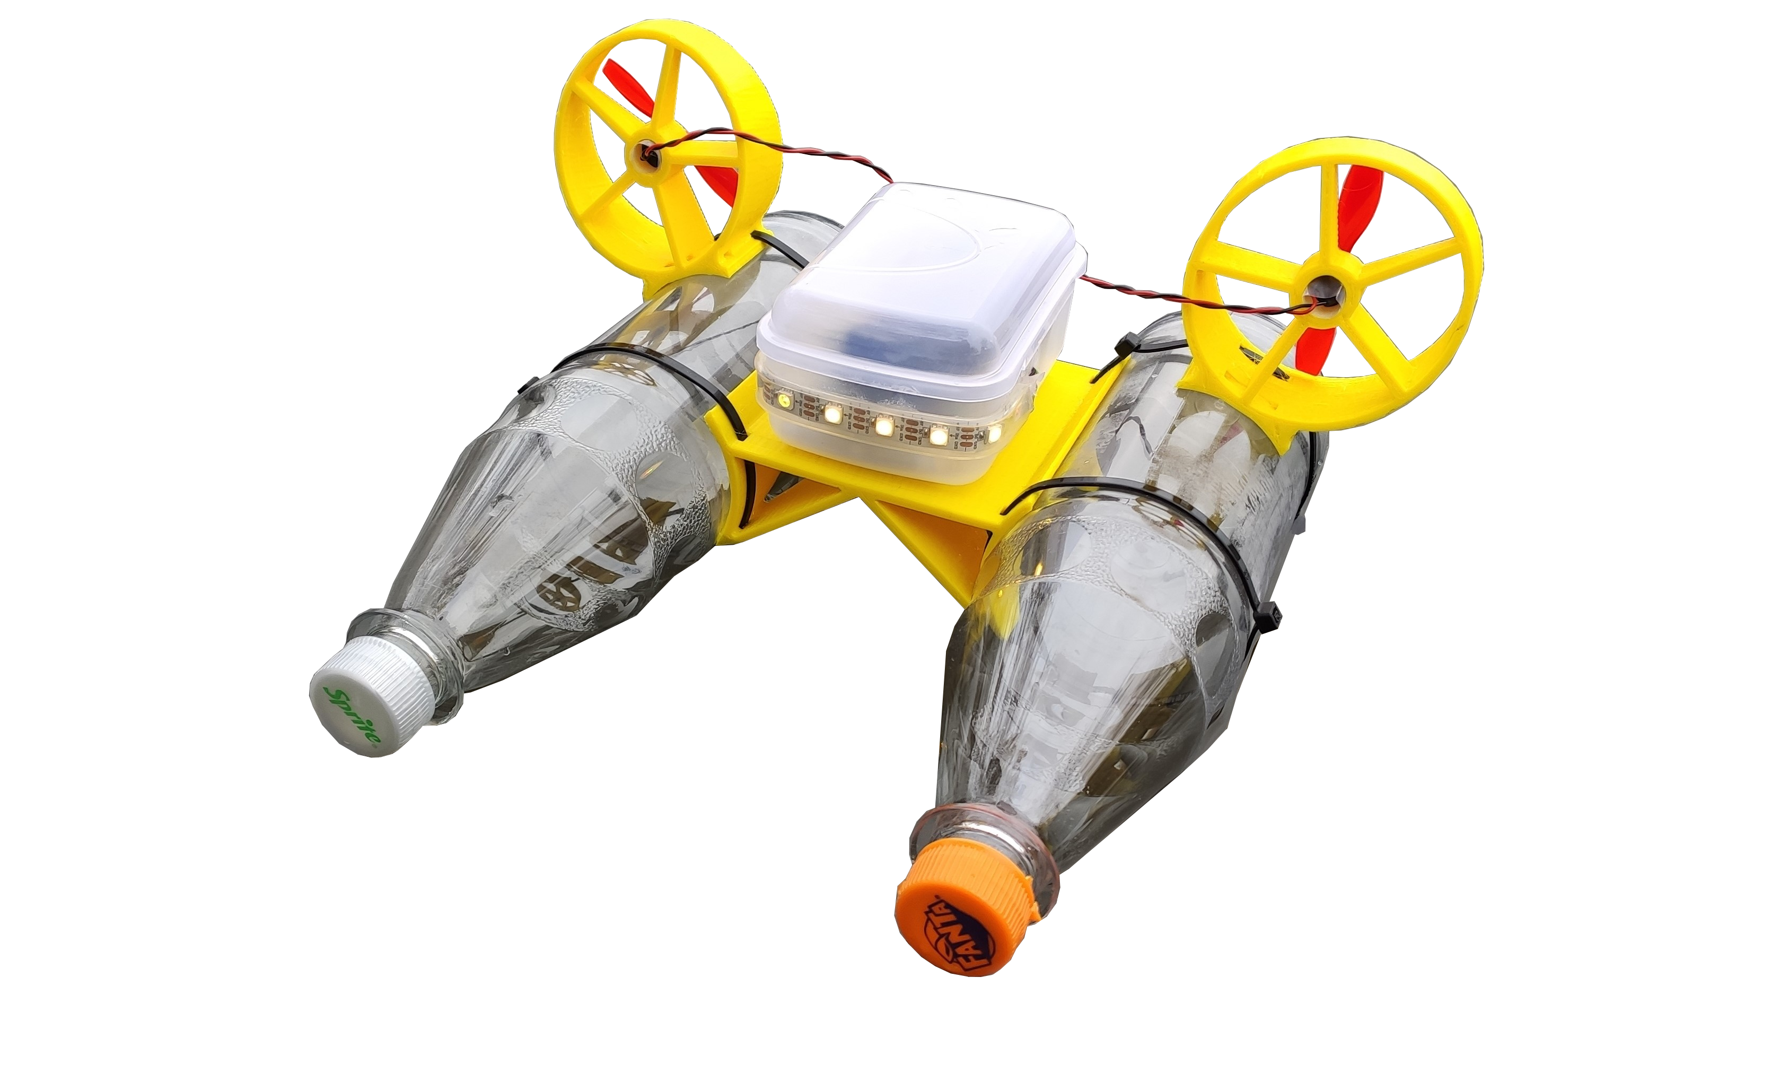


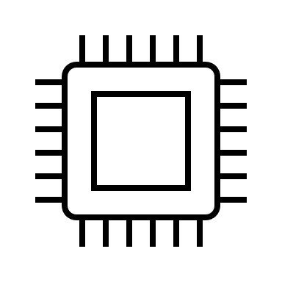

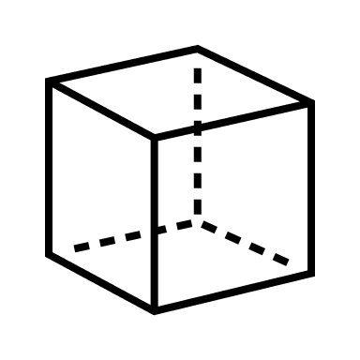
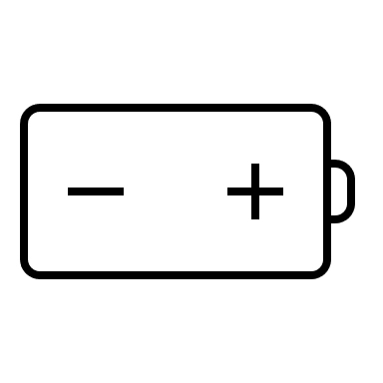
Mini Kenterprise Features
Companion Website
A HTML5 website that can
be used with a regular web browser
Motors with Propellers
Allow the boat to drive forward and reverse and rotate around its center.
WiFi Connection
To control the boat with any mobile device.
LED Strip
Can glow in different colors and looks cool..
Microcontroller
The programmable brain of the boat.
Recycled Bottles
Make up the main parts of the hull.
3D Printed Parts
Allow the boat to be build with a couple of zip ties.
Rechargable Battery
Self made powerbank with a single lithium ion cell.

Slide 3
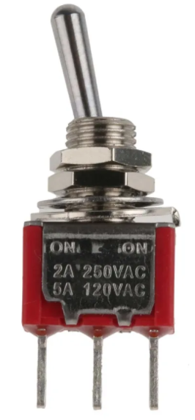
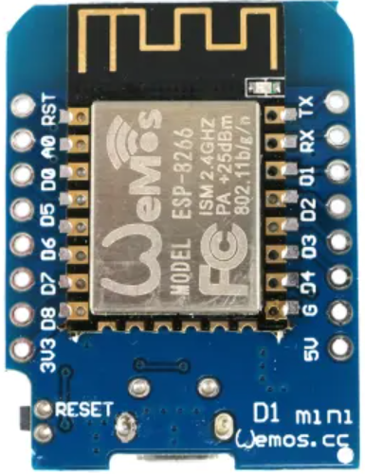
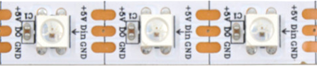
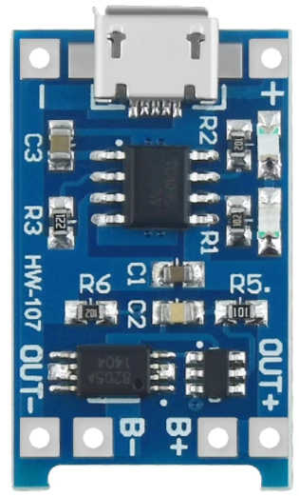
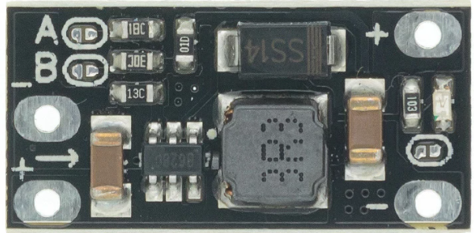
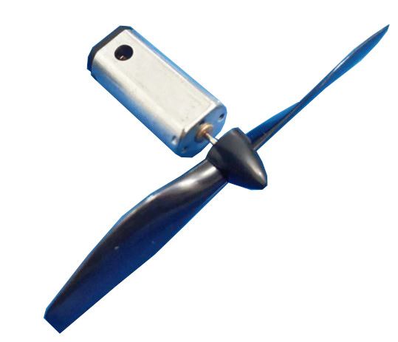
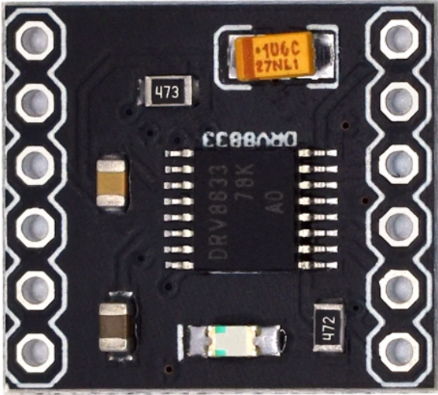
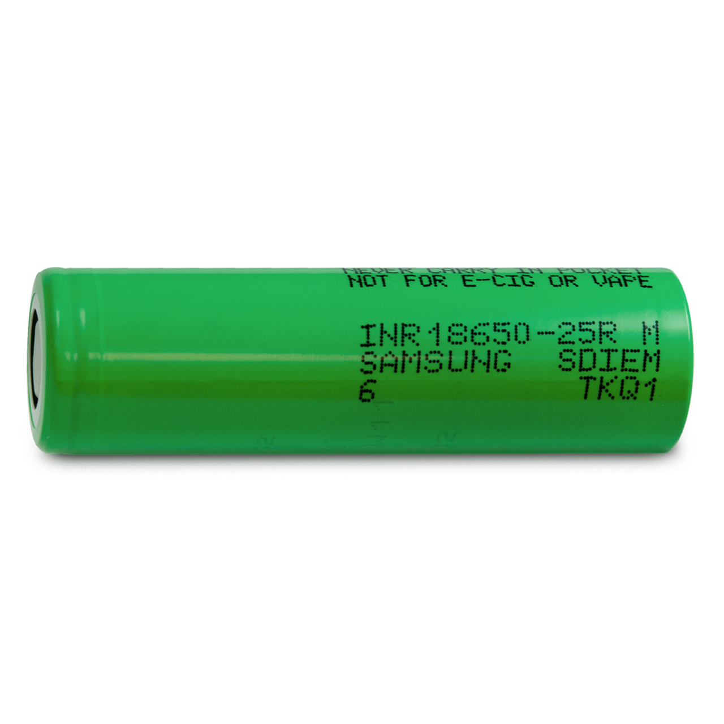
Schaltplan
Schalter
Controller
[ WEMOS D1 Mini ]
LED‘s
[ WS2812B ]
180K
BMS
[ TC4056 + Discharge Protection]
Voltage Booster
[ Step-Up 5V Out ]
Motors
[N20 5 V ]
Motortreiber
[ DRV8833 H-Bridge ]
Battery
[ 18650 Li-Ion Zelle ]

Slide 4
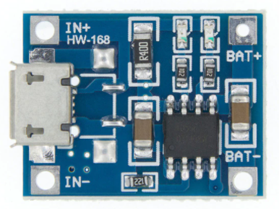
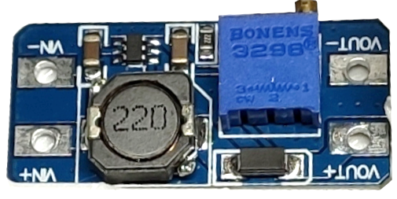
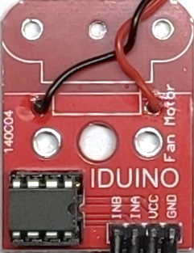
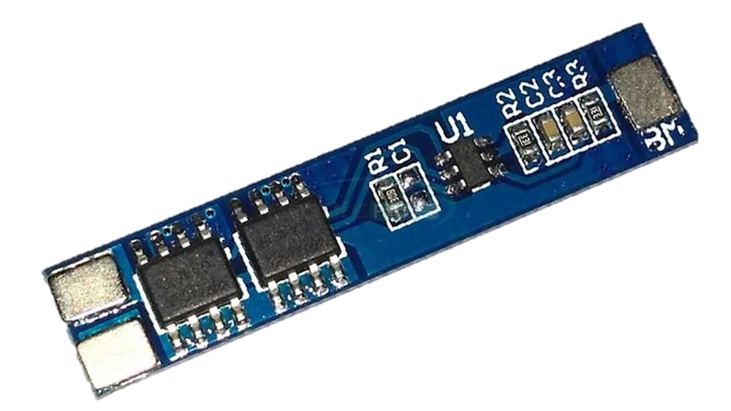
Circuit Diagram for Version 1
Power Supply Section
Boat System
Controller
[ WEMOS D1 Mini ]
Switch
Resistor
LED‘s
[ WS2812B ]
180K
Charger
[ TC4056 ]
Voltage Booster
[ Step-Up 5V Out ]
Motor Driver
[ L9110 Module ]
Battery
[ 18650 Li-Ion Cell ]
Motors
[N20 5 V ]
BMS
[ 9205A + 2xDW01 ]

Slide 5
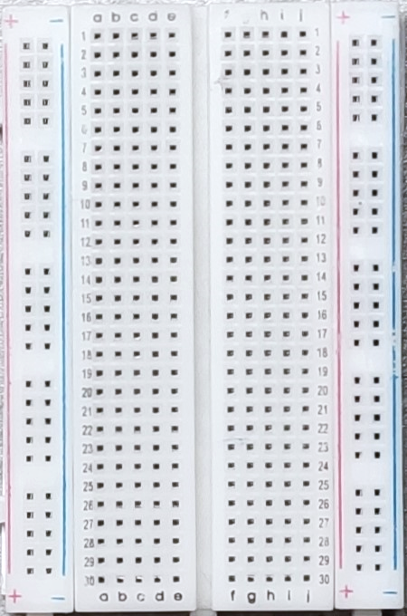
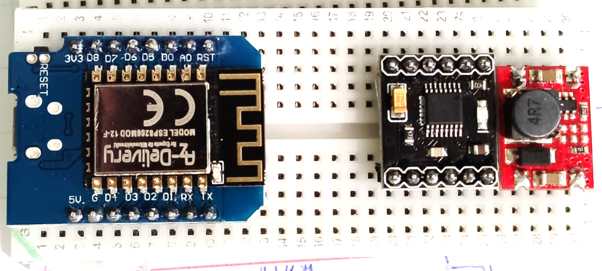
Breadboard Layout for Version 1
Battery Voltage
180K
Motor Driver 1
Power Supply
Section
Motor Driver 2
5V
LEDs

Slide 6
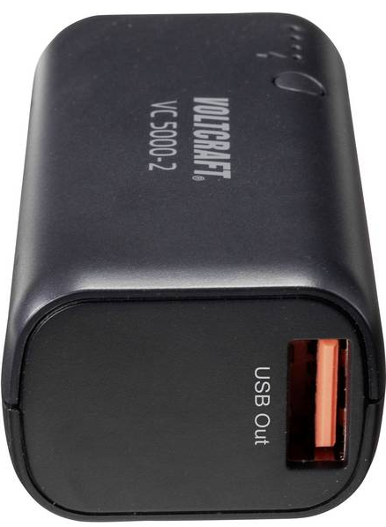
Circuit Diagram for Version 1 (with Powerbank )
Power Supply Section
Boat System
Controller
[ WEMOS D1 Mini ]
Switch
*no voltage Sensor
LED‘s
[ WS2812B ]
Power Bank
Motor Driver
[ L9110 Module ]
Motors
[N20 5 V ]

Slide 7
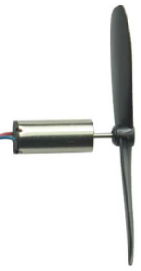
Circuit Diagram for Version 2
Power Supply Section
Boat System
Switch
Controller
[ WEMOS D1 Mini ]
LED‘s
[ WS2812B ]
Charger
[ TC4056 ]
Resistor
180K
Voltage Booster
[ Step-Up 5V Out ]
Motors
[N20 3.7 V ]
Battery
[ 18650 Li-Ion Cell ]
Motor Driver
[ DRV8833 H-Bridge ]
BMS
[ 9205A + 2xDW01 ]

Slide 8
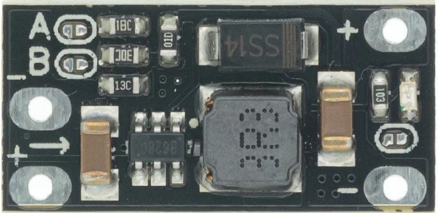
Breadboard Layout for Version 2
Power Supply
Section
Battery Voltage
180K
M1
M2
LEDs

Slide 9
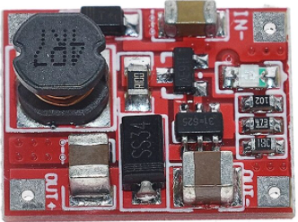
Circuit Diagram for Version 3
Power Supply Section
Boat System
Switch
Controller
[ WEMOS D1 Mini ]
LED‘s
[ WS2812B ]
Charger
[ TC4056 ]
Resistor
180K
Voltage Booster
[ Step-Up 5V Out ]
Motors
[N20 3.7 V ]
Battery
[ 18650 Li-Ion Cell ]
Motor Driver
[ DRV8833 H-Bridge ]
BMS
[ 9205A + 2xDW01 ]

Slide 10
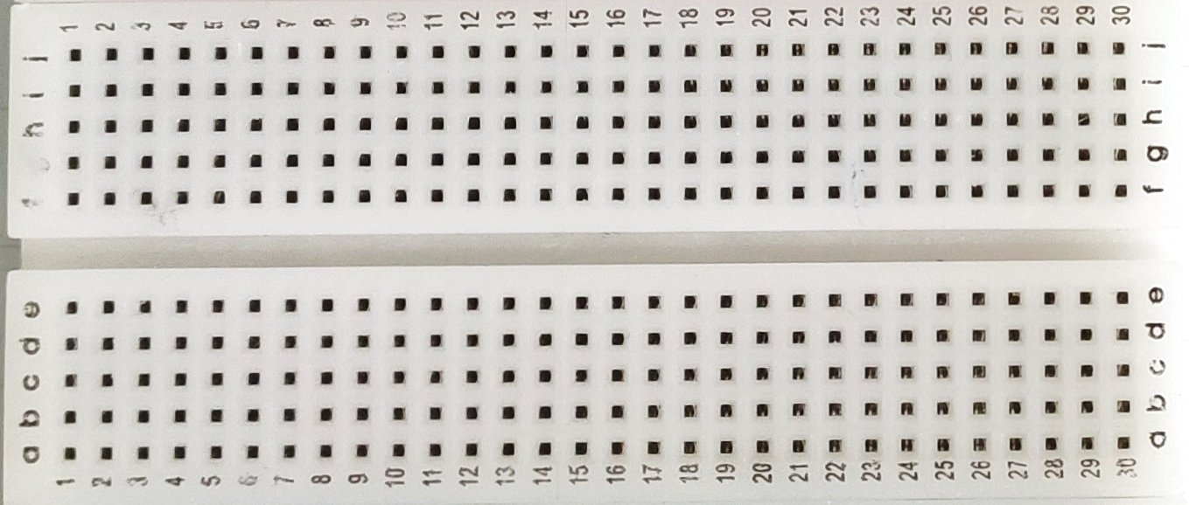
Breadboard Layout for Version 3
Battery + BMS +
Charger + Switch
180K
LEDs
M1
M2

Slide 11

Smartphone
Companion Website
User
WiFi Network
HTTP
WebSocket
Mini
Kenterprise
Microcontroller
Motor Driver
LED Strip
Left Motor
Right Motor

Slide 12
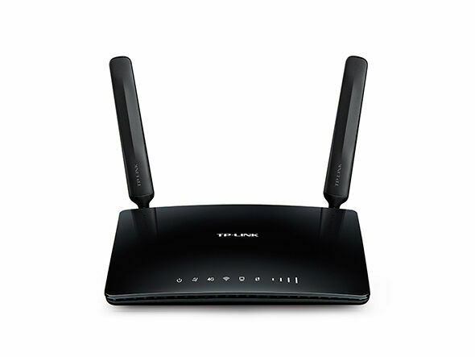

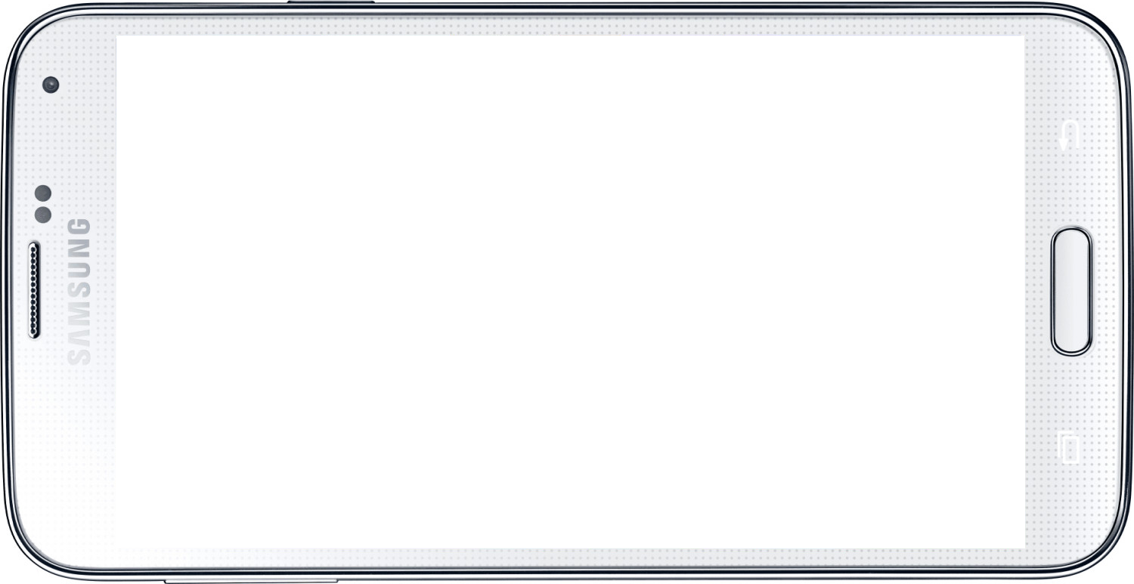
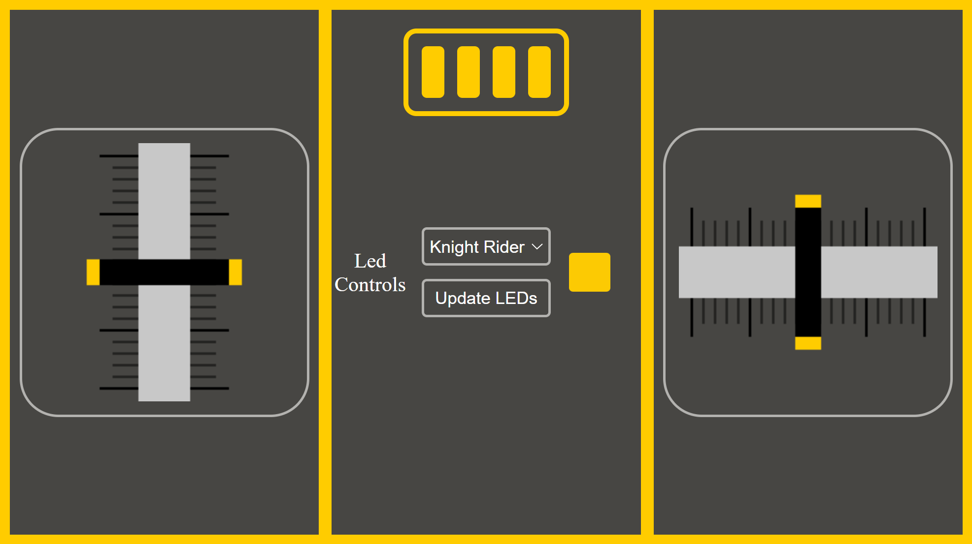



Wifi Router
Communication via WiFi Network
[ HTTP, WebSocket ]
Mini Kenterprise
Smartphone
Communication in Access Point Mode
[ HTTP, WebSocket ]
Companion Website

Slide 13
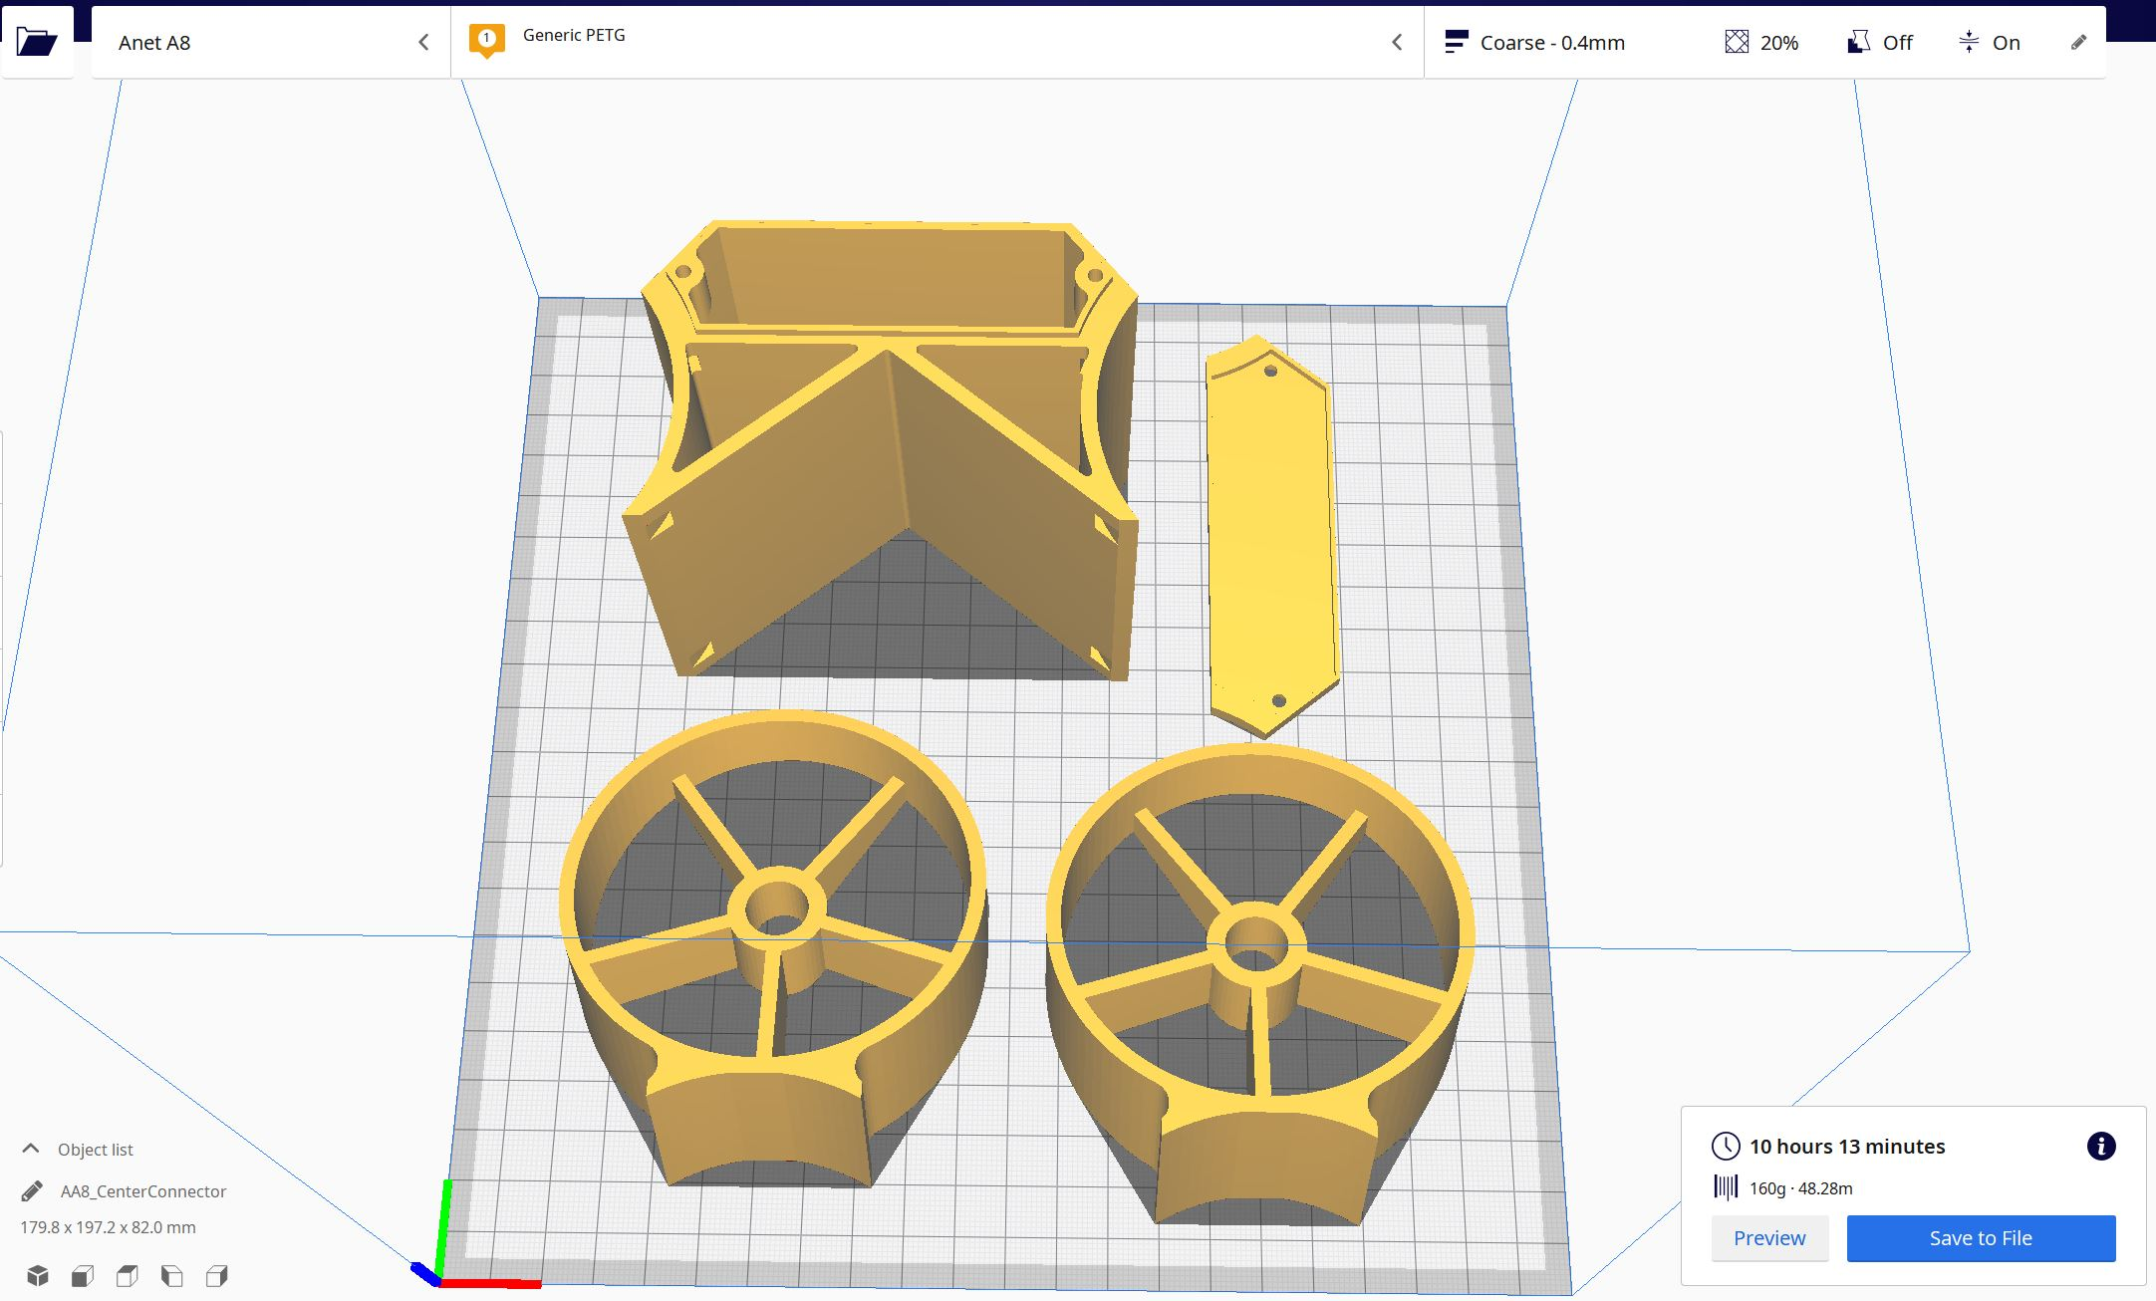
3D Druck

Slide 14
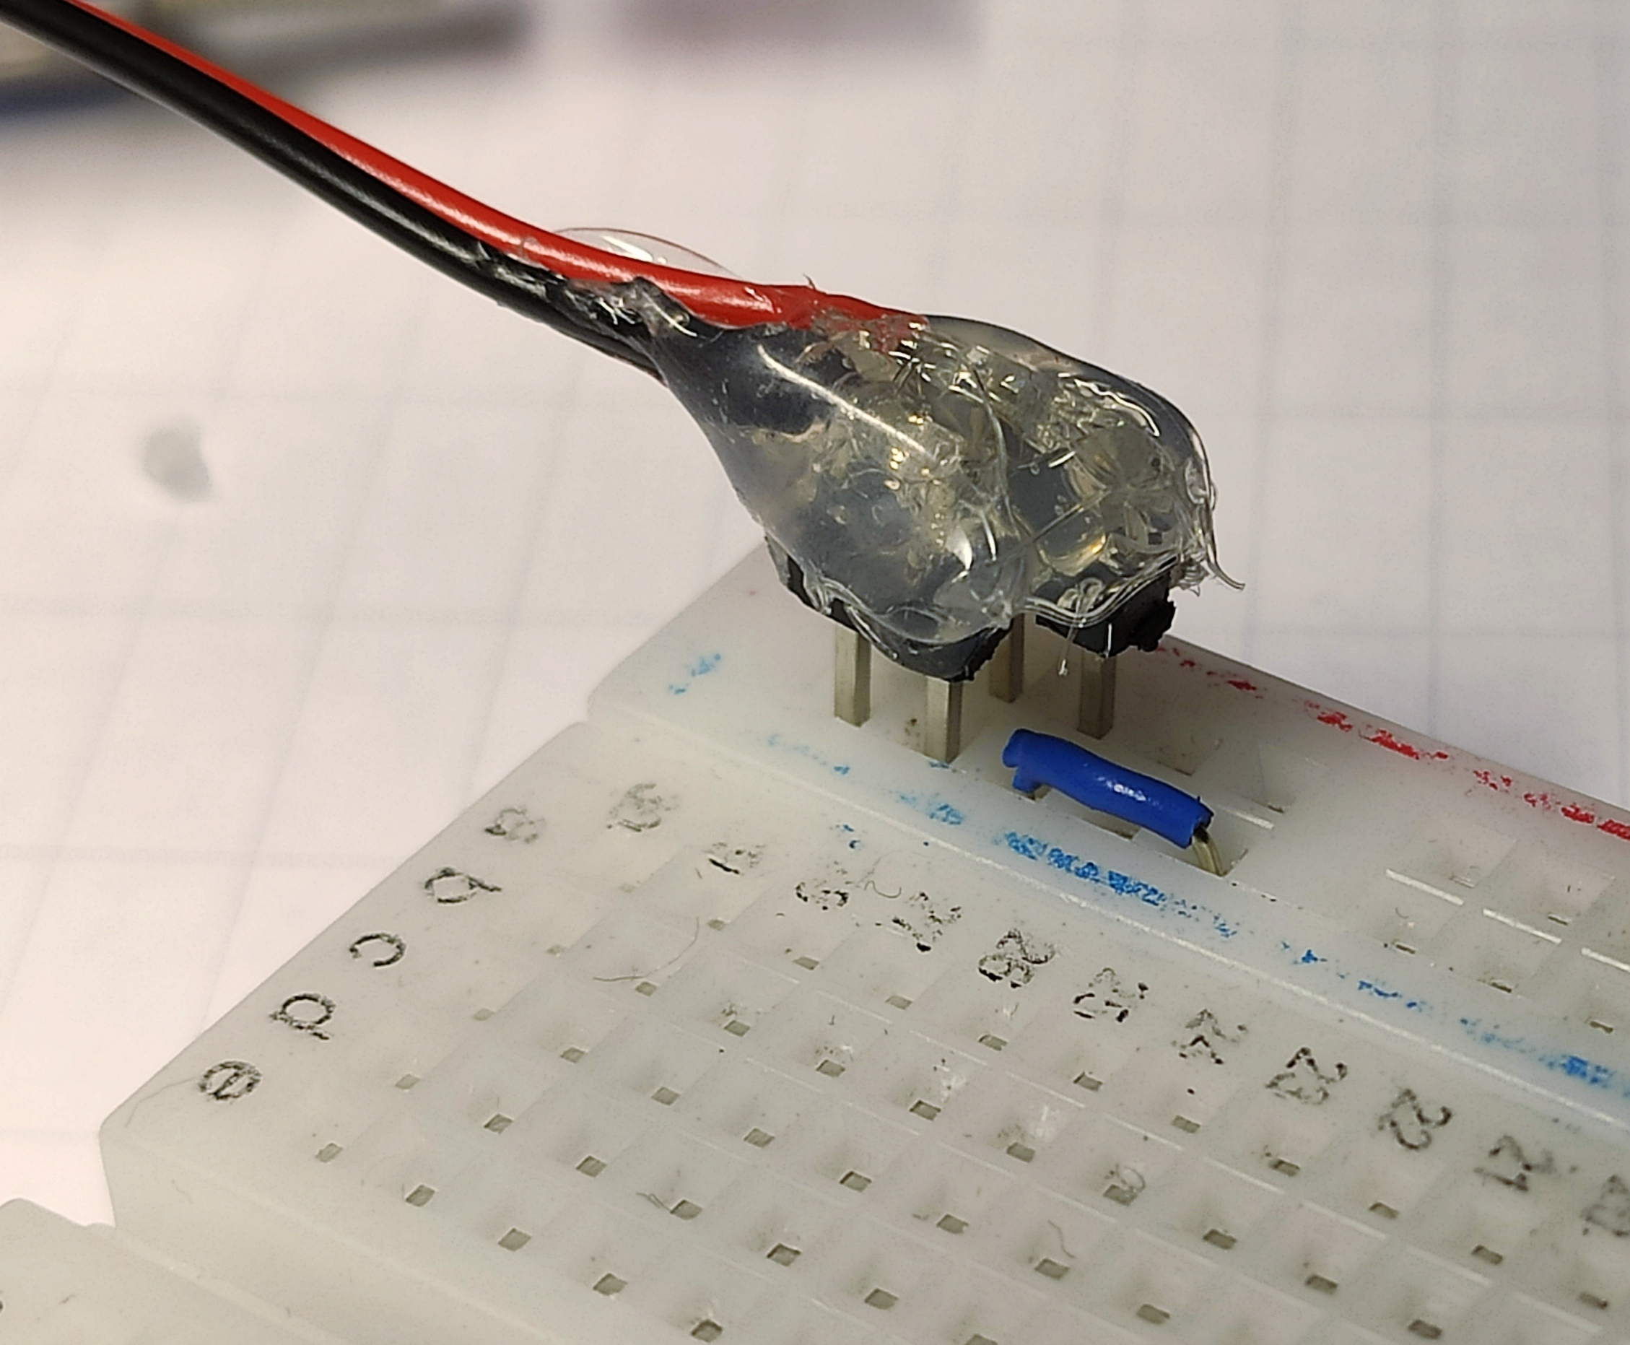
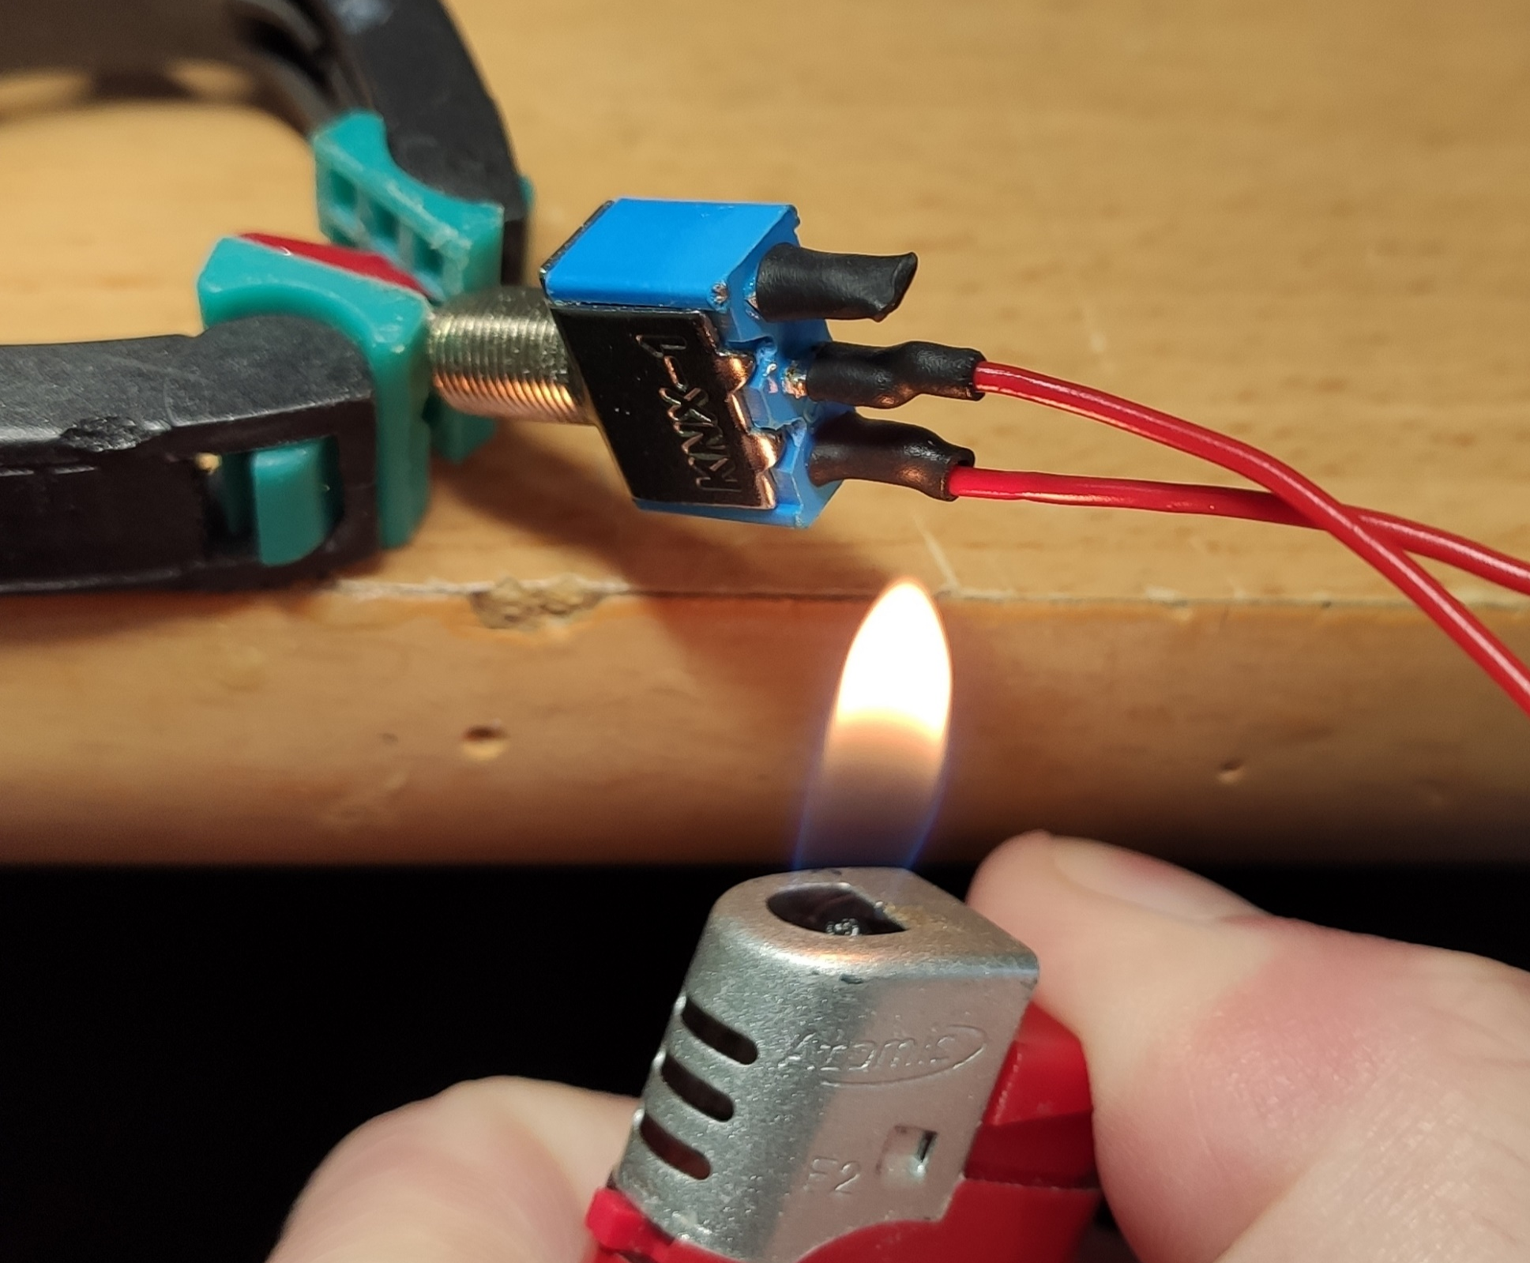
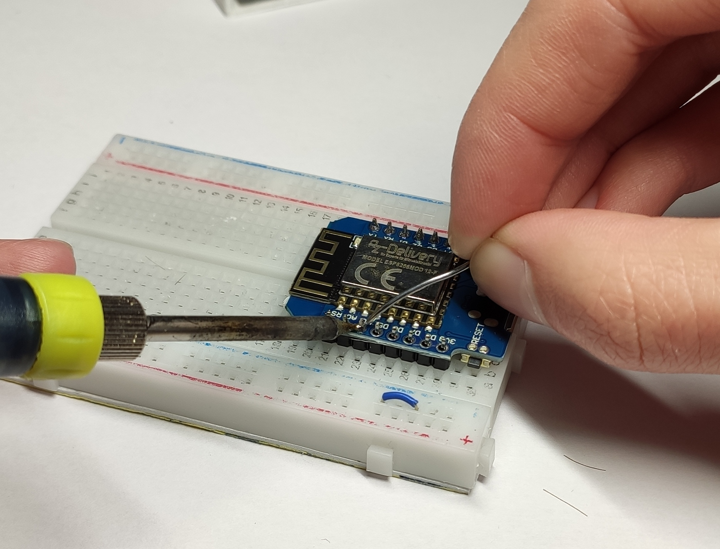
idiot proof power connectors
shrink tubing for isolation
pins on modules

Slide 15
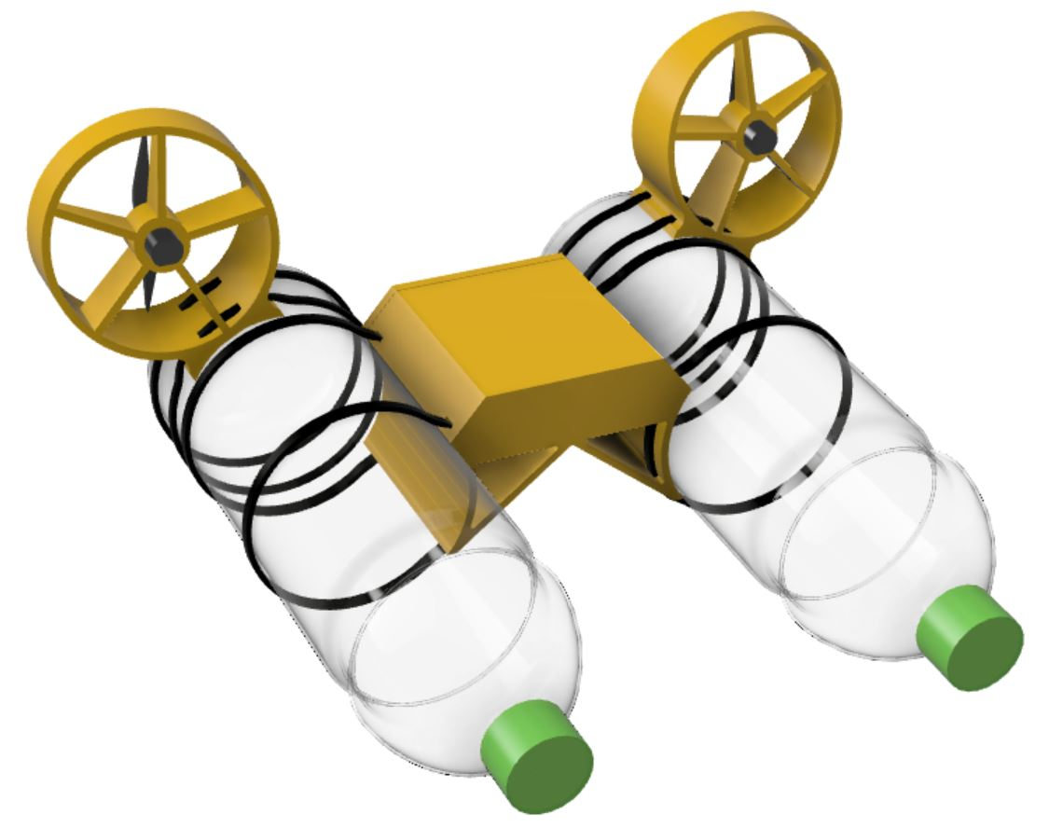
Funktionen
Die Mini Kenterprise ist ein einfaches Elektrobot, dass sich über eine WLAN-Verbindung mit einem Smartphone (oder Tablet, Laptop) fernsteuern lässt
Das Boot hat folgende Besonderheiten:
Antrieb über 2 Propeller
Wiederaufladbar über Micro-USB
4 RGB-LEDs für verschiedenfarbige Leuchtmuster
3D-gedrucktes Elektronik-Gehäuse
Rümpfe aus PET-Flaschen
Zusammenbau mit Heißkleber und Kabelbindern

Slide 16
Modell
Motor-Gehäuse
[ 3D-gedruckt ]
Propeller
[ 76mm ]
Kabelbinder
[ 200mm 4,3mm ]
Motor
[N50 3,7-4,2 V ]
Elektronik-Box
[ 3D-gedruckt ]
Rumpf
[ 1L PET-Flasche (dickwandig) ]

